Slide 1
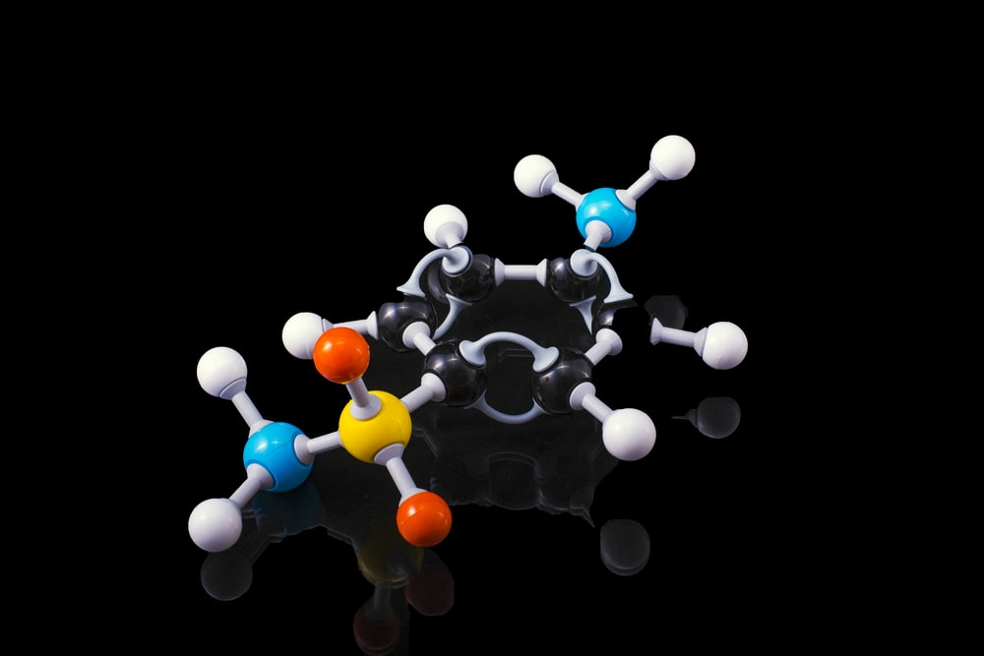

Data Science in Healthcare & Pharma Industry
Anish Mahapatra | 7 September, 2021

Slide 2

Agenda
01
Introduction
02
The Pharma Industry
03
Application of Data Science in Healthcare
04
The Data Science Process Flow
05
Use-cases for Pharma in Analytics
06
Q&A Session

Slide 3
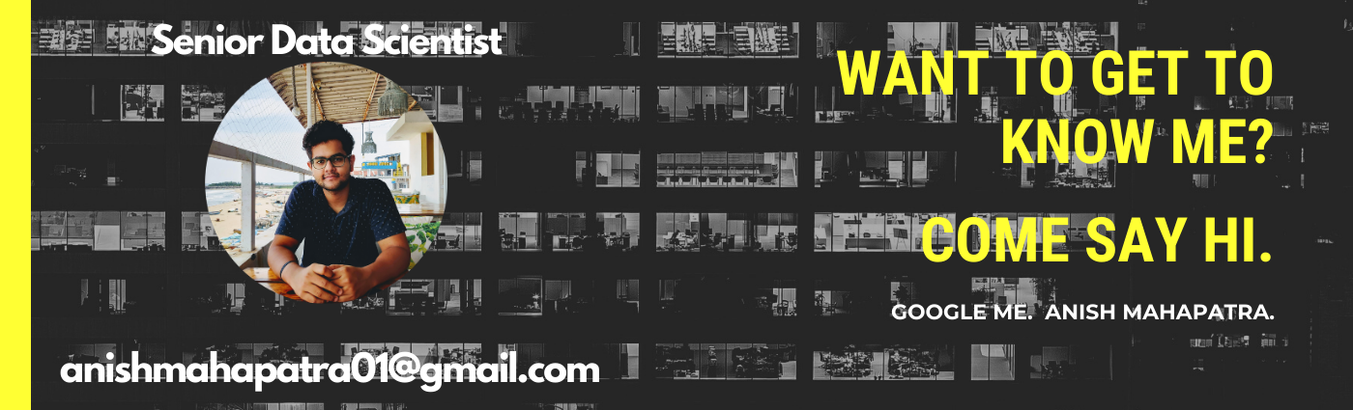





Topic 1 of 6
Introduction
Senior Data Scientist
LinkedIn: www.linkedin.com/in/anishmahapatra Medium: anishmahapatra.medium.com Twitter: @_anishmahapatra
GitHub: www.github.com/anishmahapatra
Email: anishmahapatra01@gmail.com
Q. How to get into Data Science?
A. Simple, ask a real-world Data Scientist.

Slide 4
Topic 2 of 6
The Pharma Industry
01
02
03
Pre-Clinical Phase
Initial Registration
Clinical Trials
Drug Discovery & Design (Clinical Plan) followed by Formulation Design & Regulatory Approval (FDA, EMA)
Registration of API, Regulation of Clinical Trial & Development followed by Risk Management Plan
Phase 0, Phase 1, Phase 2 and Phase 3 followed by evaluation of Marketing Authorization
06
05
04
Post Marketing Survey
Supply Chain Management
Drug Production
Pharma Co-vigilance, Renewal/ Cancellation of Marketing Authorization and further development of the drug
Packaging, Inventory Management, Transportation, Drug Distribution, Track & Trace and Marketing
After successful clinical trials, MAA & NDA approvals, Drug Manufacturing is started
Notes:
Source: Product Lifecycle_V8 (happiestminds.com)

Slide 5




Topic 3 of 6
Application of Data Science in Healthcare
The pharma industry was valued at $390 billion in 2001 and is now worth $1.27 trillion.
The expected CAGR over the next decade is about 11.5%.
Patient
Drugs
Business
Innovation
Advanced RWE driven Analytics
Risk Monitoring using Digital Health (IoT)
Electronic Medical Records (EMR)
Yield Optimization
E2E Digital Twin simulation
Explainable AI (XAI)
Market Mix Modelling
Real-time predictive analytics
Commercial-spend optimization
Rapidly personalized content
Agent Based Modelling
Intelligent Search System
Notes:
Source:

Slide 6


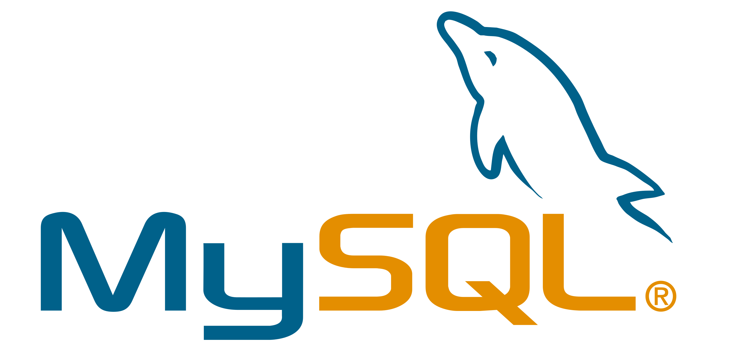















Topic 4 of 6
The Data Science Process Flow
1 Get Data from Data Silos
6 Impact Analysis
Bring data from data silos to data warehouses (ETL)
Data Science is experimental. Fail fast and build faster to maximize profit
2 Understand what the business does
5 Present to the
Business Stakeholders
The business already does things a certain way. First, match the business to show business impact
Analytics is only helpful to the business if it helps them make money. Data Science is Business, Mathematics & Technology.
3 Data Engineering
4 Machine Learning
Orchestrate and build pipelines to automate the process
Models are of three main types: Heuristics-based, Statistical or AI/ML

Slide 7






Topic 5 of 6
Use Cases for Pharma Industry in Analytics
Accelerate Drug Discovery & Development
Reduce Cost & Increase Drug Utilization
With the patents of blockbuster drugs expiring, pharma companies are looking to accelerate time to market leveraging innovation
Granular cost of key metrics will help pharmaceutical businesses to make smarter decisions based on past performance
Personalized & Targeted Medicine
Effective Sales & Marketing
Personalized medicine based on unique genomics to create more effective solutions for users’ problems
An optimized marketing mix spend along with close-range tracking of sales can help make better & faster decisions
Increase Efficiency of Clinical Trials
Data Mining to capture Data of Interest
Leveraging multiple demographic and personalized data points can help accelerate the tedious process of clinical trials
Capturing competitor and product details can help the healthcare industry react better and plan for the future

Slide 8

Data Science in
Healthcare & Pharma
Anish Mahapatra
Q&A Session
Anish Mahapatra
LinkedIn: www.linkedin.com/in/anishmahapatra
Email: anishmahapatra01@gmail.com

Slide 9
Data Science in
Healthcare & Pharma
Anish Mahapatra
Thank you.

Slide 10




Topic 1 of 6
Introduction
The telecom industry is valued at $1658 billion. The percentage of customers a telecom operator can retain decides the profits of the company.
The Cost of Customer Acquisition
Acquiring new customers is 5-10 times more expensive than keeping existing customers loyal
The Cost of Customer Churn
The cost of customer churn is $10 billion globally every year
The Average churn rate of customers
Companies, on average lost 10-30% of their customers annually
The Profits from Customer Retention
If customer retention cost was increased by 5%, profits would increase by 50-75%

Slide 11






Topic 2 of 6
Literature Review
Exploratory Data Analysis
Modelling
Visual analysis, univariate analysis, bivariate analysis,
Single machine learning models, meta-heuristic models, hybrid models, data mining techniques
Feature Selection
Evaluation Metrics
Mostly XGBoost was used to conduct feature selection
The models were evaluated using accuracy or AUC scores are the primary methods of assessment
Feature Engineering
Gap: Interpretable Machine Learning
Box Cox Transformation, Class Balancing, Handling Categorical variables, Standardization, Normalization
There was a gap of research that had good results and performed interpretable machine learning

Slide 12
Topic 3 of 6
Aim and Objective
Aim
The aim of the paper is to develop a trustworthy and interpretable model that will predict customers that will churn.
Objectives
Visualize patterns of customer behavior
Feature Selection to identify important attributes
Implement class balancing techniques to improve model performance
Develop and evaluate machine learning models
To help the business make sense of predictions, leverage interpretable machine learning

Slide 13
Topic 4 of 6
Research Methodology
01
02
03
Exploratory Data Analysis
Statistical Tests
Feature Engineering
Data Understanding, Distribution of variables, Missing Value Analysis, Outlier Analysis, Bivariate Analysis
Chi-Square Test, ANOVA, Probability Distribution using Kernel Density Estimation
One-Hot Encoding, Feature Importance Analysis, Standardization (After train - validation - test split), Class Balancing
06
05
04
Model Interpretability
Model Evaluation
Model Building
Model Interpretability using Locally Interpretable Model - Agnostic Explanation (LIME) and Shapely Additive Explanations (SHAP)
Model Evaluation on Train-Validation-Test Data, after Class Balancing, and after Oversampling using SMOTE-NC
Train-test split, Baseline models, Hyperparameter tuning, Class Balancing - Oversampling using SMOTE-NC,

Slide 14
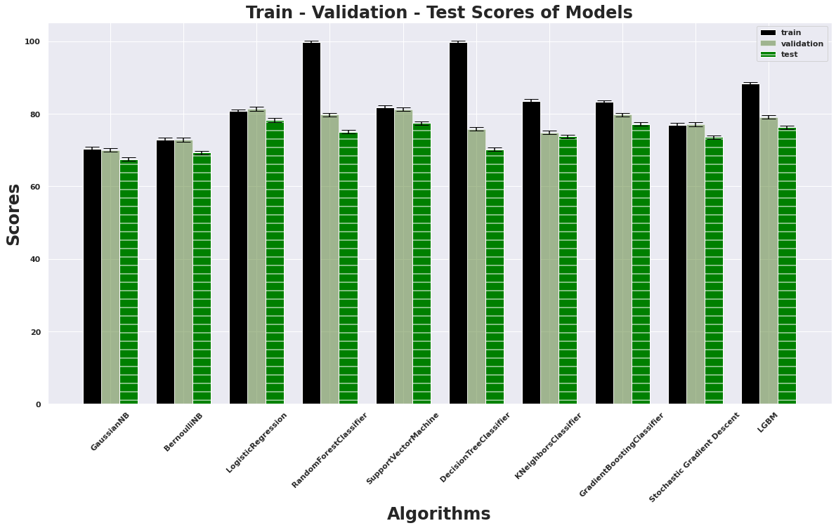

Topic 5 of 6
Results | Train-Validation-Test
The data has been split into train, test and validation
Logistic regression has the highest accuracy on the test data of 78.30%
Bernoulli Naïve Bayes has the highest AUC Score of 0.74
Random Forest and Decision Tree are overfit on the train data with accuracies of 99.75%
Support Vector Machine and Gaussian Naïve Bayes are the other models that performed well
Light GBM
Logistic Regression
Bernoulli NB
Gaussian NB
Random Forest
Decision Tree
Gradient Boost Classifier
SVM Classifier
K Neighbor
Stochastic Gradient Descent
Algorithms

Slide 15
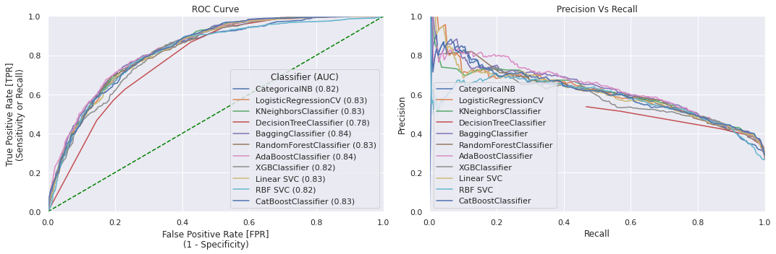
Topic 5 of 6
Results | Model Performance
The results are obtained after class balancing using SMOTE-NC and hyperparameter tuning using Randomized Search CV
All models (except one) have AUC scores of greater than 0.80 and test accuracy scores of greater than 70%
The Decision Tree AdaBoost Classifier and Bagging Classifier have the highest AUC score of 0.84
XGBoost and CatBoost are the ensemble models that have the highest accuracy of about 76%

Slide 16
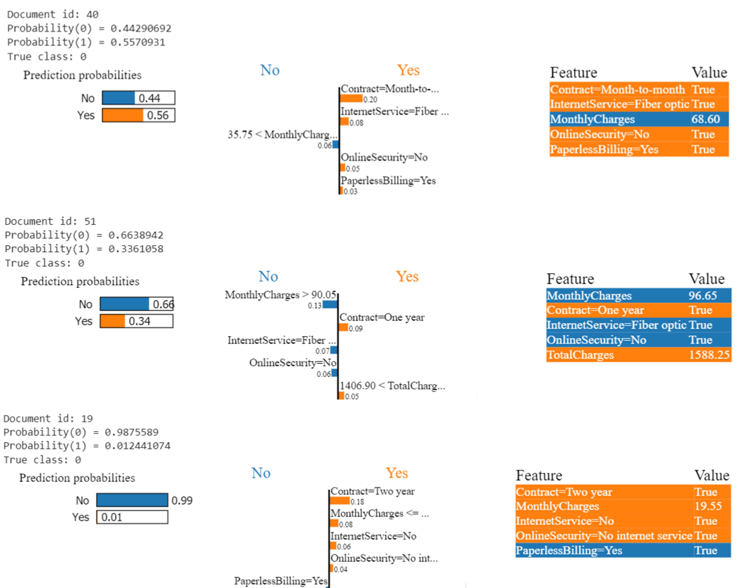
Topic 5 of 6
Results | Interpretable Machine Learning
LIME stands for Locally Interpretable Model Agnostic Explanation
The output is a set of explanations that explain each feature’s contribution to predicting a data point
SHAP is used for global interpretation of the features using Shapely values

Slide 17
Topic 6 of 6
Conclusions and Future Recommendations
Conclusions
Interpretable machine learning models such as SHAP and LIME can help the business understand the underlying mechanism of the predictions by the models
The pipeline that gives the best result includes class balancing using SMOTE-NC, performing cross validation and hyperparameter tuning using Randomized Search CV
One of the better models obtained was CatBoost with an AUC score of 0.83 and accuracy of 76.45.
Ensemble models with balanced data tend to give better results as compared to individual machine learning models

Slide 18
Topic 6 of 8
Conclusions and Future Recommendations
Future Recommendations
Deep Learning models can be attempted to leverage the interconnections within the data to provide better results
The suggested pipeline can be attempted in a real world setting to check revenue generated
More factors such as demographic information, streaming data and more historical records can be included in the machine learning modelling pipeline to improve performance

Slide 19

Prediction of Customer Attrition in the Telecom Industry using Machine Learning
Anish Mahapatra |
Thank you.

